Slide 1
New Teaching Assistant Orientation
Graduate College

Slide 2
Welcome!
Associate Dean of the Graduate College
Dr. Algerian Hart

Slide 3
Addressing Concerning Student Behavior
Andy Englert, Associate Director, University Safety
Adapted from:
Laura Bennett, Harper College
Mike Jungers, Missouri State University

Slide 4
Introduction
Dr. Andrea Weber, Dean of Students
  Chair
    836-5527
    PSU 405
Anna Clark
  Care Consultant, Dean of Students Office
    836-5527
    PSU 405
Notes:
Mention Dr. Weber maternity leave and sending concerns to DOS Office

Slide 5
What does the Dean of Students Office do?
Facilitates the process for addressing student concerns
Helps faculty, staff and students understand parameters for appropriate student behavior
Ensures students’ rights are protected
  Communicates complaint/appeals procedures
  Interprets and enforces FERPA
Coordinates BIT – MSU’s BEHAVIORAL INTERVENTION TEAM
Notes:
Dean of Students Office Mission – to empower students to achieve personal and academic goals and to help reduce the barriers that might be impeding reaching those goals.
Share who is on BIT
Ask – How many are returning Graduate Teaching Assistants? Have you ever experience disruptive behavior in the classroom? How did you handle it?

Slide 6
Students May:
Be different
Have a psychological condition
Have a disability (and disclose/not disclose to MSU)
Challenge your opinion or information
Have a criminal history
Be entitled or self-centered
Have different cultural expectations
Notes:
Over 23,000 students on campus coming with a variety of backgrounds, characteristics, and life experiences. So we see a diverse array of behaviors.
1 in 5 college students are experiencing, have experienced or will experience with some type of mental illness.
1 in 11 college students will have a visible or hidden disability and many of those students may not disclose their disability to MSU.

Slide 7
Students May Not:
Disrupt the educational environment so that other students can’t learn
Engage in or threaten violence towards others
Fail to comply with directions of college officials
Violate the Student Code of Conduct
Notes:
If fact, we have a classroom disruption academic policy that states the course instructor has jurisdiction over his/her class and may deny a student who is unduly disruptive the right to attend class. Of course, we want to see removal of a student as a last resort, so the expectation is that the instructor meets with the student after the initial disruption and give the student a chance an opportunity to change before you withdraw the student.
The next three bullet points are in fact violations of the Student Code of Conduct, which can be found on the Dean of Students Website.

Slide 8
Accountability Measures
Available processes at MSU to communicate expectations and effectively respond to student behaviors:
  Student Code of Conduct
  Campus policies and rules
  Interim action when situation warrants
  Laws and police responses
Notes:
We talk about expectations of being a member of an academic community with students in SOAR, GEP 101, RA presentations and other programs. Be familiar with what behavioral expectations are written in the syllabus for the course you are assisting with.

Slide 9
Q: What are students’ rights?
Students have rights, including to be informed of what is expected of them and what the process is if they violate those expectations.
Student Code of Rights and Responsibilities
Requirements for Academic Programs
Other College policies and procedures
If a student may have violated college policies, he/she should receive due process:
    Notice of possible violation(s)
    Opportunity to respond (a hearing)
    Appeal/File Complaints
Notes:
Important to note that students in addition to having responsibilities also have rights as a member of an academic community.

Slide 10
Q: How do I balance students’ rights and MSU standards?
    Communicate what is expected of students, using relevant behavioral expectations found within the course syllabus and other department publications
Inform students of complaint procedures/options
Consistently uphold appropriate academic standards
Document student behaviors, your conversations and interventions, and the student’s response
Notes:
These are good examples of classroom management techniques.

Slide 11
Behaviors that May Cause Discomfort or Annoyance
Staring
Not picking up on social cues
Interrupting you
Talking loudly
Asking a lot of questions
Talking about things that don’t relate to class
Standing within personal space boundaries
Wanting to speak to your supervisor/chair
Disrespectful/rude behavior
Threatening to sue you
Monopolizing your time
Crying
Not listening to you
Not doing homework
Not engaging in class
Answering phone, talking, texting, on computer in class
Emailing incessantly

Slide 12
Disruptive
Behaviors and Indicators
Behaviors that may disrupt the educational process:
Yelling or being excessively loud
Excessive hygiene concerns
Under the influence of substances
Refusing to leave or cooperate
Destruction of property
May also include:
Not complying with instructions
Escalating low-level behaviors

Slide 13
Threatening & Concerning
Behaviors and Indicators
Acts of physical aggression
Threats of violence
Articulation of depression, hopelessness, or self-harm
Mention of weapons or violence to solve problems
Expressions of anger/agitation/inability to cope with stress
Reports of abuse
Notes:
Three types of student behaviors that typically come to our office’s attention and they tend to fall along a spectrum ranging from threatening and concerning behaviors to disruptive behaviors to behaviors that may cause discomfort or annoyance. Thinking about your past experience as a student, have you witnessed any of these behaviors? How were they handled?

Slide 14
Campus Resources
Departmental:
  Supervising Faculty Member
  Department Head/Dean
Campus Offices: (consultation, referrals)
  Counseling Center
  Magers Health and Wellness Center
  Disability Resource Center
  Academic Advising Center

Slide 15
More Campus Resources
BIT (Behavioral Intervention Team)
  Resource for MSU Community who have concerns about a student’s behavior
  Guide campus interventions prior to a crisis
  Can use the Incident Reporting Form at http://www.missouristate.edu/dos/
Student Conduct
  Office of Student Conduct, Dean of Students Office
  File formal complaints of Code violations
  Must be based on actual behavior, not just speculation
Springfield Police Department, MSU substation
  Respond in an emergency
  Take reports of violations of law

Slide 16
Difficult Conversations
State your expectations for future behaviors
Describe likely consequences of non-compliance:
  Meeting with the Department Head and then Dean
  Referral to Dean of Students
Inform of any likely follow-up:
  Email or letter to document conversation
  Report to Department Head
  Contact to campus resources
  Set a date to discuss progress/give feedback

Slide 17
Documentation/Follow Up
Following any incident:
Document the situation
  Personal notes
  Email to student
  Email to department head/supervisor and/or Dean of Students
Report it to supervisor, BIT, and any other appropriate source.

Slide 18
Q: What about FERPA & privacy?
FERPA is the law that governs student records. You should never feel concerned about sharing information about a possible threat or concern with other campus officials that have a legitimate educational interest in the information.
Once you share information and it becomes part of an official record, you could be violating the student’s privacy rights if you share it outside of a legitimate educational interest.

Slide 19
Q: What about a student with a disability?
A disability is not a reason to hold someone to a different standard.
If a student discloses a disability, inform him/her that Disability Resource Center is a resource that can assist students with disabilities. You can also contact DRC if you have questions.

Slide 20
Questions?
Dean of Students Office, PSU 405
417-836-5527
Missouristate.edu/DOS
Dr. Andrea Weber, Assistant Dean of Students &
Director of Student Conduct
AndreaWeber@MissouriState.edu

Slide 21

ACADEMIC INTEGRITY FOR TEACHING ASSISTANTS
Katie Stinnett
Academic Integrity, Program Manager
University Hall 205

Slide 22
Find the balance.
First and foremost, you are a student!
Should Do
Could Do
Would Do
No one can do everything!

Slide 23

Classifications of Academic Dishonesty:
Cheating
Fabrication or misconduct in research
Plagiarism (this includes “self-plagiarism”)
Facilitating academic dishonesty

Slide 24
Academic Integrity Reminders:
Double-dipping, recycling work = self-plagiarism
If it’s not your own thoughts and words, cite it!
Changing a few words is not enough.
Integrity matters in the virtual world, too!

Slide 25
What the Academic Integrity Office Does:
Educate to prevent
Provide support
Work with GEP 101 classes
Provide workshops and guest lectures
We are here to help!

Slide 26
How Teaching Assistants Can Help:
Report!
  Reporting a violation protects the student’s legal rights.
  Reporting is required by the Faculty Handbook.
You choose the sanction with your supervising faculty.
  The AIC will not change the sanction unless the student has multiple violations.
Work for consistency of sanctions in order to protect student rights.

Slide 27
Educational sanctions
Require student to redo assignment
Assign a zero on the assignment/test/paper/quiz
Lower the overall grade for the class
Assign an F in the course
Assign an XF in the course
  Other colleges and employers can see XFs
A combination of these sanctions
AIC sanctions:
  Suspension
  Expulsion
Possible sanctions (to be determined by the TA with supervising faculty):

Slide 28
Can you truly educate students if you allow them to cheat, plagiarize, etc.?

Slide 29
MSU Department of Safety
Foster a Safe and Secure Environment for the University Community
University Safety

Slide 30
COVID-19Know what to do
Take appropriate protective actions
  Wear a mask
  Practice Social Distancing (>6ft)
  Stay home if you are sick
  Wash your hands
  Don’t touch your face
  To report a positive COVID test or that you are a close contact call 837-3737 or email covid19@missouristate.edu

Slide 31
Emergency Notification Systems
Tornado Sirens
Missouri State Alerts
  Text
  Email
  Voice
Blue Light Phones
Fire Alarms
Building Coordinators

Slide 32
Know what to do
Take appropriate protective actions
  Shelter
  Evacuate
  Other
For all emergencies
  Call 911
  Call Safety Dispatch 836-5509

Slide 33
Sheltering
Each building has designated areas for use during severe weather emergencies, including tornados
If unsure of the shelter location, go to:
  lowest level
  interior room
  with no windows
If outside, move inside immediately
Each building’s plan can be found at:
http://www.missouristate.edu/safety/building-evacuation-and-shelter-locations-reference-chart.htm

Slide 34
Evacuation
Remain calm
Do not use elevators
Walk to evacuation areas and tell others to do the same
Offer to help those who need assistance
Move to Evacuation Destination
Do not return, until all clear is given
Each building’s plan can be found at:
http://www.missouristate.edu/safety/building-evacuation-and-shelter-locations-reference-chart.htm

Slide 35
Other
Some emergencies are unique
  Suspicious objects – Bomb threats
  Medical emergencies
  Active shooter
  Power outages
  Flooding

Slide 36
Medical Emergencies
Medical Emergency - medical condition that could result in serious injury or harm to an individual without immediate medical attention.
Protective Actions:
  Call 911 and Safety x65509
  Remain calm and keep others calm
  Provide assistance
    to your level of training

Slide 37
Medical Emergencies
Pre-actions
  Take a CPR/AED course (Compression Only or Certification)
  Take a First Aid course
  Take a Stop the Bleed course
  Know where your nearest AED is located
  Download the PulsePoint free app

Slide 38
Fire Emergency
Protective Actions:
Small Fires (size of small trash can)
  Have someone call 911 and MSU Safety Dispatch x65509
  Use the nearest fire extinguisher if you are comfortable in doing so
    Pull the pin
    Aim at the base
    Squeeze the trigger
    Sweep back and forth until completely extinguished
Large Fires (or when the alarm sounds)
  Use nearest exit to evacuate the building, close the door but do not lock it behind you
  Activate the building alarm (through fire alarm pull station located by the exit)
  Call 911 and Safety Dispatch x65509

Slide 39
Fire Emergency
Pre-Actions:
Know the location of
  Fire exits
  Fire alarm pull stations
  Evacuation Location
  Fire Extinguisher location
Take a fire extinguisher course

Slide 40
Active Shooter/Aggressor
This can include a wide variety of situations, including active and perceived violence
Protective Actions:
  Run, Hide, Fight
  Call 911 if safe to do so
  Comply with law enforcement requests

Slide 41

Run, Hide, Fight
https://www.youtube.com/watch?v=5VcSwejU2D0
The following contains graphic information about violence which may be disturbing to some.
Notes:
Please know we are talking about a difficult subject. We will likely get graphic. The goal is to have frank discussion and provide a limited amount of “fear inoculation” and help create a survivor mindset for you. However, if you need to step out to re-group, please take care of yourself.

Slide 42
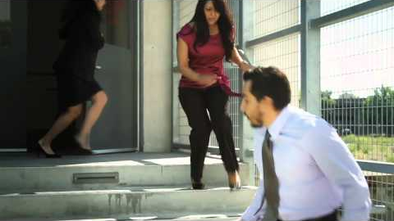
Notes:
Please know we are talking about a difficult subject. We will likely get graphic. The goal is to have frank discussion and provide a limited amount of “fear inoculation” and help create a survivor mindset for you. However, if you need to step out to re-group, please take care of yourself.

Slide 43
Police Arrival
Show them empty hands
Follow instructions quickly and calmly
Answer any questions they ask
Tell them where the attacker is
Tell them what/where the weapon is

Slide 44
Active Shooter/Aggressor
Pre-Actions
Watch “Shots Fired On Campus” on Safety’s website :
https://www.missouristate.edu/safety/hostile-intruder.htm#training_video
Get additional training from Safety
Identify exits and hiding locations

Slide 45
Bomb Threat
Via phone, note, or verbal
Get as much information as possible
Immediately notify MSU Dispatch
  x65509
Do not evacuate unless notified to do so

Slide 46
Suspicious Package
Move away from the package/object
Be aware of other suspicious objects
Call 911
Call MSU Dispatch (once away from the object)
  x65509

Slide 47
Questions?
  Karen McKinnis
  Emergency Preparedness Manager
    836-5225
    kmckinnis@missouristate.edu

Slide 48
BREAK
10:15-10:30

Slide 49

LEGAL, ETHICAL & Compliance ISSUES
Missouri State University
New Teaching Assistant Orientation
January 13, 2022
Melissa Berry
Director, Institutional Equity & Compliance

Slide 50
Legal affairs & Compliance
Office of General Counsel
Office of Institutional Equity & Compliance
Title IX Office
Deputy Compliance Officer

Slide 51
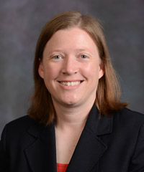
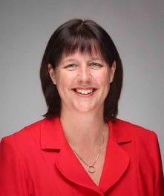
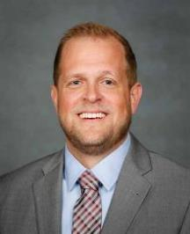
Office of General Counsel
Rachael Dockery
General Counsel
Jennifer Mueller
Assistant GC
Jeff Mitchell
Associate GC
T.J. Phinney
Paralegal
Phone: 836-8507

Slide 52
FERPA
• Family Educational Rights and Privacy Act of 1974
• Protects privacy of student educational records
• Rights belong to the student – regardless of age once attendance at a post-secondary institution begins

Slide 53
Student rights under ferpa
Inspect their educational records
Consent to disclosure of personally identifiable information (or not)
Seek corrections to inaccuracies in educational records
File complaint w/DOE if rights violated

Slide 54
Can I disclose without student consent?
Nope.
Not without consulting with the Office of General Counsel.
Even if parents or law enforcement asks

Slide 55
WHAT IF I GET A RECORDS REQUEST?
GOOD NEWS!
YOU ARE NOT RESPONSIBLE FOR ANSWERING RECORDS REQUESTS!
Send THEM TO THE OFFICE OF INTERNAL AUDIT, AS THEY SERVE AS CUSTODIAN OF RECORDS FOR THE SYSTEM.

Slide 56
Non-discrimination
HOW DOES THE UNIVERSITY ENFORCE ITS COMMITMENT TO NON-DISCRIMINATION?
IN SEVERAL WAYS.

Slide 57
Policies
Non-Discrimination Policy Statement (G1.05)
Reporting Allegations of Discrimination on the Basis of a Protected Class (G1.31)
Discrimination Complaint and Investigation Procedures (Op1.02-2)
Title IX Sexual Harassment Grievance Procedure Policy (Op1.02-11)
Accommodations and Accessibility Policies (and others, SAs…)

Slide 58
Disability Accommodations
Instructors must refer all students requesting disability accommodations to the Disability Resource Center.
From there, Instructors should provide accommodations that are
authorized by the DRC and
requested by the student.
If this is a problem, talk to your supervisor and the DRC.
See Disability Accommodation Policy for Students

Slide 59
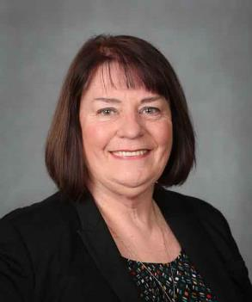
Employee accommodations & Pregnancy Accommodations
  EMPLOYEES CONTACT:
  JULIA HOLMES
  DEPUTY COMPLIANCE
  OFFICER
  (417) 836-6755
  See 0p1.02-5 Employee Disability Accommodation Policy & Procedures

Slide 60
RELIGIOUS ACCOMMODATIONS
Instructors must provide students who expect to miss classes, examinations, or other assignments, as a consequence of their sincerely held religious belief with a reasonable alternative opportunity to complete such academic responsibilities
(e.g., excused absences, alternative assignments that are no more difficult than the initial assignment, etc.).
Concerns/questions? Your supervisor and Deputy Compliance Officer.
See Accommodations for Religious Observances Policy

Slide 61
REPORTING COMPLAINTS
  Instructors are required by policy to report discrimination, harassment, or retaliation.
  When? ASAP, but never later than 3 days.
  Even if the situation is resolved, you must report.
  Even if the victim does not want to file a complaint or requests confidentiality, you must report.

Slide 62
To whom do I report?
Report complaints of discrimination based on a Protected Class to:
Melissa Berry,
Director, Institutional Equity & Compliance;
        Interim Title IX Coordinator
Carrington 205
(417) 836-5252
MBerry@MissouriState.edu
              Equity@MissouriState.edu
              TitleIX@missouristate.edu

Slide 63
If you want to get fired . . .
Ignore everything I’m about to tell you.

Slide 64
MAINTAINING BOUNDARIES
Faculty members - including teaching assistants –
are NOT allowed to have sexual or romantic relationships with their students.

Slide 65
POP QUIz: question #1
The day before the final exam, a student comes to you and says, “I need an extra hour on my final because I have a disability.”
What do you do?

Slide 66
POP QUIz: question #2
One of your students makes a racist comment during class.
What do you do?

Slide 67
POP QUIz: question #3
A female student approaches you and indicates that she is having pregnancy complications that may require her to be absent from your lab from time to time. Attendance is a crucial component of lab, such that points are tied to attendance.
What do you do?

Slide 68
POP QUIz: question #4
A student approaches you the day before an exam and requests that he be given an alternate testing date, as the exam is scheduled during Ramadan. You’re pretty sure that observance of Ramadan lasts a full month and only requires fasting from dawn until sunset. The exam is is scheduled for 10 am on a Monday!
What do you do?

Slide 69
POP QUIz: question #5
A student in your class is behaving erratically. She frequently interrupts the classroom lecture or discussion to share conspiracy theories unrelated to the subject matter at hand.
What do you do?

Slide 70
Overview of Title IX
The Education Amendments of 1972
  “No person in the United States shall, on the basis of sex, be excluded from participation in, be denied the benefit of, or be subjected to discrimination under any educational program or activity receiving federal financial assistance.”

Slide 71
Title IX prohibits :
Umbrella Term: Sexual Harassment
-Hostile Environment Harassment: Conduct, based on sex, that is severe, pervasive and objectively offensive such that it denies equal access to MSU programs and activities, based on a reasonable person standard.
-Quid Pro Quo Harassment:
  An employee of MSU conditions the provision of some aid, benefit, or service on another person’s participation in unwelcome sexual contact.
-Sexual Assault
-Dating and Domestic Violence
-Stalking
Notes:
The increase in access to people due to SOCIAL MEDIA has dramatically increased stalking of both men and women.
If someone tells you to leave them alone, you must leave them alone.
Don’t wait to report:
Stalking is a very compulsive behavior.
Typically it increases in intensity and severity over time.
Come to us, we can help.

Slide 72
Other Issues Our Office Will Help With
Sexual Misconduct
Sexual Discrimination (including, based on)
  Sexual Orientation
  Gender Identity or Gender Expression
Sexual Harassment under Title VII
  that is severe, pervasive or objectively offensive

Slide 73
Daunting Statistics
Among undergraduate students, 26.4% of women and 6.8% of men experience rape or sexual assault
January 2020 report by the Association of American Universities.
1 in 4 undergraduate women experience some form of nonconsensual sexual contact.
Association of American Universities, Sarah Brown 2019 study.
The great majority of these assaults will occur between people who know each other.
Department of Justice, Office of Justice Programs, Bureau of Justice Statistics, Sex Offenses and Offenders (2014)

Slide 74
Risk Factors
Being female
Freshman and sophomore years
Prior abusive relationship
Frequent attendance at fraternity parties
Membership in a sorority
Identifying as LGBTQ+
Disability status
International Student status
Notes:
A National Intimate Partner and Sexual Violence survey reported that bisexual men and women were at greatest risk for victimization.
The lifetime experience of members of the LGBTQ+ community being sexually assaulted is much higher than the rate for heterosexual men and women.
Rates of partner violence in same-sex couples is about the same as occurs in heterosexual couples.

Slide 75
many reasons why a victim might not report
Self-blame
Reaction of friends and families
Fear of attacker / Threats from attacker
Fear of not being believed
Relationship with attacker
Memories of past abuse
Fear and distrust of the investigative process
Be SUPPORTIVE. Counterintuitive behavior of victims is normal when they have been through a traumatic experience.

Slide 76
Who Can Make a Report
Anyone.
MSU employees required to report discrimination or harassment involving members of the MSU community!
  Whether they know a little or a lot about the situation
  Even if a student asks them not to tell…
  Report AS SOON AS POSSIBLE to TIX Office,
  but must be within 3 calendar days of learning of the concern or allegation.
Exceptions: Magers Health and Wellness employees and Counseling Center Clinicians

Slide 77
Title IX Office Can Help
There are processes in place to address reports.
Parties will be treated respectfully.
Confidential (only those with a legitimate need to know)
Retaliation is prohibited.
Professionals involved will be conflict and bias free.
Interim measures may be available.
No matter when or where it happened, or who was involved, we can try to help, though our options will be different depending on who / what was involved and where it may have happened.
Notes:
Mutual No Contact Directives
Counseling referrals
Housing and Academic accommodations
Security escorts around campus
Modified work and class schedules

Slide 78
To whom do I report?
Report complaints of discrimination based on a Protected Class to:
Melissa Berry,
Director, Institutional Equity & Compliance;
        Interim Title IX Coordinator
Carrington 205
(417) 836-5252
MBerry@MissouriState.edu
              Equity@MissouriState.edu
              TitleIX@missouristate.edu

Slide 79
POP QUIz: question #6
You observe a male student put his arm around a female student and she shrugs him off. She appears upset.
What do you do?

Slide 80
POP QUIz: question #7
A student confides in you that a faculty member frequently makes jokes with sexual innuendos in his presence and asked him to her apartment. Although the student is very uncomfortable with the situation, the student has asked you to keep it confidential.
What do you do?

Slide 81
POP QUIz: question #8
You are very attracted to a student in your class. The student has asked you to their apartment for dinner.
What do you do?

Slide 82
Learn More
About Title IX: Title IX Resources
    Title IX Office
    (417) 836-6810
    TitleIX@missouristate.edu
Non-sex-based complaints based on a PC: Office for Institutional Equity and Compliance
    Office for Institutional Equity and Compliance
    (417) 836-4252
    Equity@MissouriState.edu

Slide 83
Questions?
Rachael M. Dockery
General Counsel & Chief Compliance Officer
Carrington Hall 205
(417) 836-8507
RMDockery@MissouriState.edu
Melissa Berry
Director, Office Institutional Equity & Compliance
Interim Title IX Coordinator
(417) 836-4252
Mberry@MissouriState.edu

Slide 84
Academic Policies & Processes, Student Records
Angela Young, University Registrar
Shannon Holt, Associate Registrar

Slide 85
Topics to Cover
Family Educational Rights and Privacy Act (FERPA) and directory information
Class Lists
Grading
Non-attendance reporting
Refund and Drop Deadlines

Slide 86
FERPA
FERPA is a federal law designed to:
protect the privacy of educational records – this prevents us from sharing a student’s non-directory information without the student’s written consent
establish the right of students to inspect and review their educational records
provide guidelines for the correction of inaccurate and misleading data through informal and formal hearings

Slide 87
FERPA – Directory Information
Directory information that may be disclosed to a third party without the student’s written consent includes but is not limited to:
Name
Address
Telephone number
Campus email address
Field of study, including majors, minors, certifications, and pre-professional areas of study
Classification (e.g., sophomore)
Enrollment status (full-time, part-time, or less than part-time)
www.missouristate.edu/policy/Op5_11_1_StudentRights.htm

Slide 88
FERPA
No other information outside of directory information may be released without the student’s written consent
Penalties for FERPA violations can mean loss of federal financial aid for the entire University
A FERPA hold may be requested by currently enrolled students. This agreement means that the University may not release any directory information about the student (except as permitted under the provisions of FERPA). The University may not even acknowledge to third parties that the person is a student at the institution.
http://www.missouristate.edu/registrar/FERPA_FAQ.htm

Slide 89
FERPA – Information You Never Give Out
Information you never give out includes:
Social security number. You cannot ever give out the student's social security number, you can't post it, you can't even use some or part of this information to confirm a student's identification.
Citizenship
Gender
Ethnicity
Religious preference
Grades
GPA
Daily class schedule. This is really important. Local police authorities may be trying to find your student. Parents may be asking what classes the student is in today. You can't give that out. This even means to parents who are paying the bills.

Slide 90
FERPA – Maintaining Confidentiality
Academic information on your students should be kept confidential at all times
Do not publicly post grades using personally identifying information or allowing easy identification of the student (i.e., listing in alphabetical order)
Be careful not to create an environment whereby students can easily discern other’s grades (passing out papers, etc.)
Avoid making available any documentation that lists both a student’s name and BearPass Number together
You should not view information that is not required in order to fulfill your job responsibilities

Slide 91
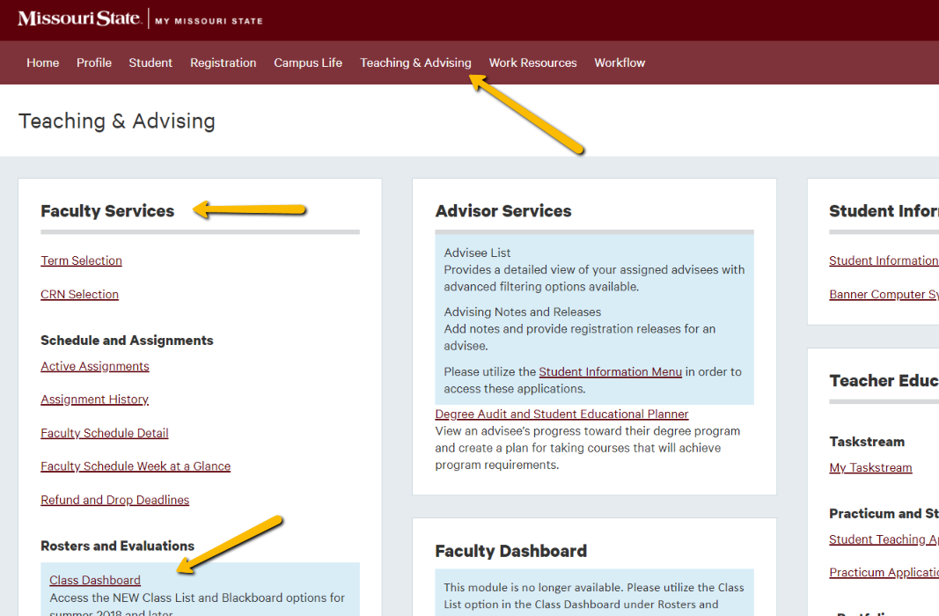
Class Lists
All class lists must be obtained through My Missouri State. To obtain your class list follow these steps:
Log into My Missouri State and navigate to the Teaching & Advising tab
Click on Class Dashboard in the Faculty Services channel
Choose Class List, Spring 2022 (or your desired term) and then select View My Classes and submit search.
Click on the CRN to view the class list online, or select Attendance Sheet or Class Report for a download of your roster.

Slide 92
Reviewing Your Class List
Review your class list periodically.
First day of class
The second week of classes (after the Change of Schedule Period)
After the last day to drop (last day to drop for spring 2022 is April 18 for full term classes)
Reviewing your class list periodically will help you identify:
Students attending who are not on your list
Students not attending who are on your list

Slide 93
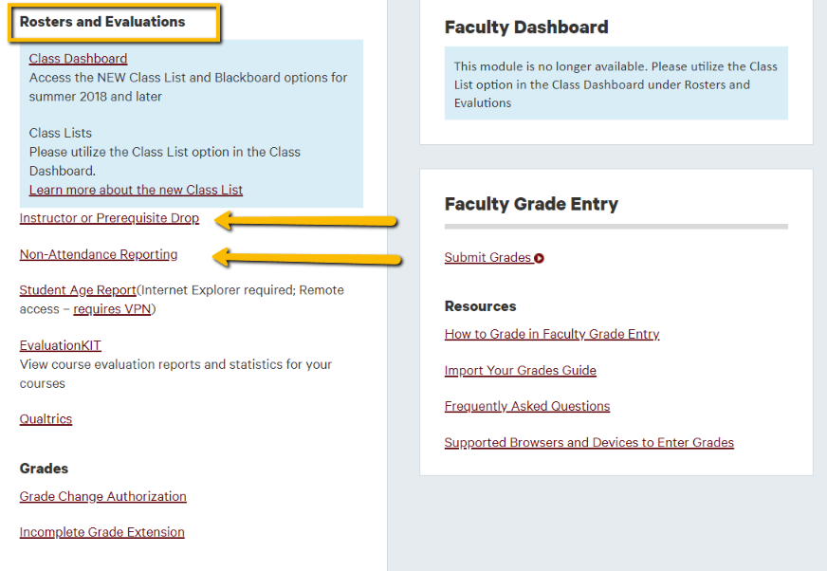
Non-attending Students
Students who do not attend during the first 3 weeks of class:
Complete Instructor Drop Form by the end of the 3rd week of the semester
Students who stop attending after the first 3 weeks:
Report non-attending students to the Office of the Registrar by completing online form

Slide 94
Attending Students Who Are Not on Your Class List
If a student’s name does not appear on your class list by January 24, the student is not enrolled and should not be allowed to attend the class without taking steps to get enrolled.
Only allow the student to attend if you can verify enrollment
  Ask student for a current copy of class schedule
  Contact the Office of the Registrar to verify - registrar@missouristate.edu

Slide 95
Mid-Term Grading
You must assign mid-term grades to all students in all full semester 100 and 200 level courses
Mid-term grades must be submitted via the Faculty Grade Entry system in My Missouri State by 2:00 p.m. on March 23, 2022
If you do not have a grade to assign, then an “I” (incomplete) grade is appropriate; however it is best for the student to have a grade to assign
Mid-term grading is available and helpful for all students in full-term classes

Slide 96
Final Grades
Final grades must be submitted through the Faculty Grade Entry system in My Missouri State no later than 2:00 p.m. on May 23, 2022
Use the Faculty Grade Assignment Channel or “Grades (Final)” link on the Teaching and Advising tab of My Missouri State to submit your grades.
Blackboard grades are not official. Grades must be submitted through the Faculty Grade Entry system.

Slide 97
Drops and Refunds
Students can find a personalized Refund and Drop Deadlines page on the Registration Tab in My Missouri State.
Faculty can find personalized Refund and Drop Deadlines for all classes they teach on the Teaching & Advising Tab in My Missouri State.

Slide 98
Additional Information Sources
Missouri State University web sites have extensive information. The following web sites are frequently viewed:
University Academic Calendar: www.missouristate.edu/Registrar/academic-calendar.htm
Office of the Registrar: www.missouristate.edu/registrar
Office of the Provost: www.missouristate.edu/provost
University Catalog: www.missouristate.edu/catalog
FERPA Training & Resources: www.missouristate.edu/ferpa

Slide 99
How to Contact Us
Office of the Registrar
Carrington Hall Room 320
Phone: 417-836-5520
Fax: 417-836-6334
E-mail: registrar@missouristate.edu
Angela Young, Registrar: AngelaYoung@missouristate.edu
Nathan Hoff, Associate Registrar: NathanHoff@missouristate.edu
Rebecca Harbaugh, Associate Registrar: RebeccaHarbaugh@missouristate.edu
Shannon Holt, Associate Registrar: ShannonHolt@missouristate.edu
Katrina Chavez, Assistant Registrar: Kchavez@missouristate.edu

Slide 100
Questions?

Slide 101
Materials Not Presented

Slide 102

IRB Processes
Office of Research Administration
Marina Loveland, IRB Administrator
August 11, 2020

Slide 103
What Requires Review

Slide 104
What Requires Review
Does the project involve research?
Research means a systematic investigation including research development, testing and evaluation, designed to develop or contribute to generalizable knowledge.
  Systematic Investigation is an activity that utilizes scientific methods (either quantitative or qualitative) in an orderly process of data gathering.
  Generalizable Knowledge involves any information generated from data collected to describe, inform, generate, or test hypotheses that will be shared with others in any public or semi-public venue other than closed meetings and/or the classroom. This would include dissemination of collected information through journal publication, conference presentations, newsletters, thesis, or posting on the internet.

Slide 105
What Requires Review
Does the project involve human subjects?
Human subject means a living individual about whom an investigator conducting research:
  Direct Contact - Obtains information or biospecimens through intervention or interaction with the individual, and uses, studies, or analyzes the information or biospecimens; or
  Secondary Data – Obtains, uses, studies, analyzes, or generates identifiable private information or identifiable biospecimens.

Slide 106
Required Training

Slide 107
Required Training
Human Research Training
Human Research Training is required for all IRB applicants/investigators:
  Basic course must be taken (Biomedical or Social-Behavioral-Educational)
  Refresher course is required every three years after the basic course has been completed.

Slide 108
Required Training
HIPPA Training – if applicable to project
If you will be working with or obtaining protected health information as part of your research, HIPPA Training will be required.

Slide 109
Required Training
How to complete training
All required training can be completed through the CITI Program.
Training can be completed here: https://www.citiprogram.org/
Instructions for CITI Human Research Training can be found here: https://ora.missouristate.edu/Assets/ora/Registering_and_Signing_up_for_the_Correct_Course_at_CITI.pdf
Instructions for HIPAA Training (CITI Health Information Privacy and Security (HIPS) Training) can be found here: https://ora.missouristate.edu/Assets/human/RegistrationGuidelinesforHIPAAtrainingforMSUwithCITI.pdf

Slide 110
Submit Your Application

Slide 111
Submit Your Application
Requesting an Account for cayuse IRB
In order to submit an application, you must have an account with Cayuse IRB. You can request your account from here: https://ora.missouristate.edu/Cayuse_Logon.asp
It can take up to 48 hours for you logon information to populate within Cayuse IRB.

Slide 112
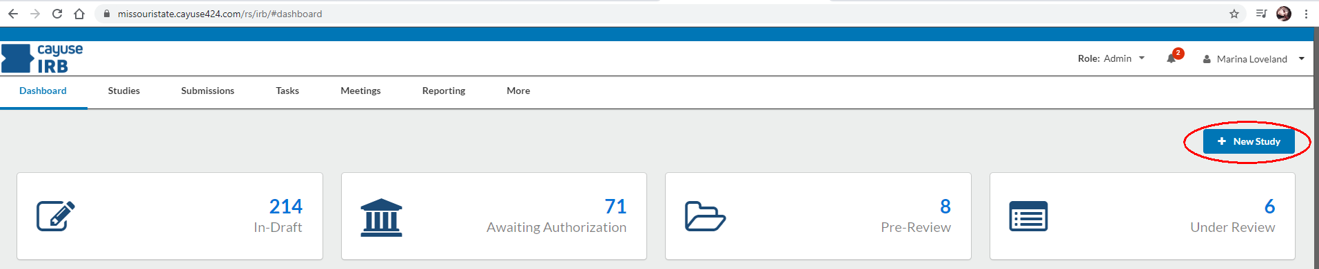
Submit Your Application
Creating an application
To Create a new study, click the New Study button in the upper right-hand corner of your screen:

Slide 113
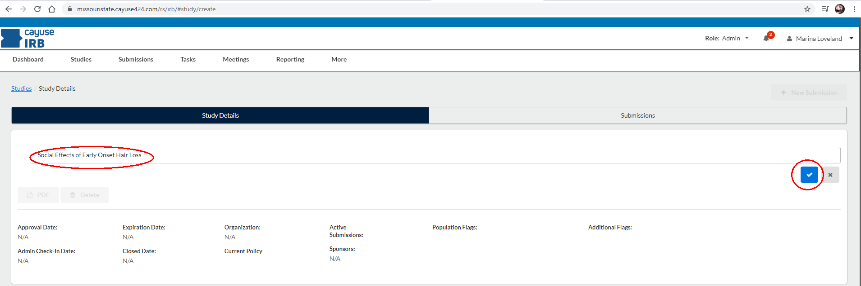
Submit Your Application
Creating an application
Enter the title of your study. Then, click the Save button:

Slide 114
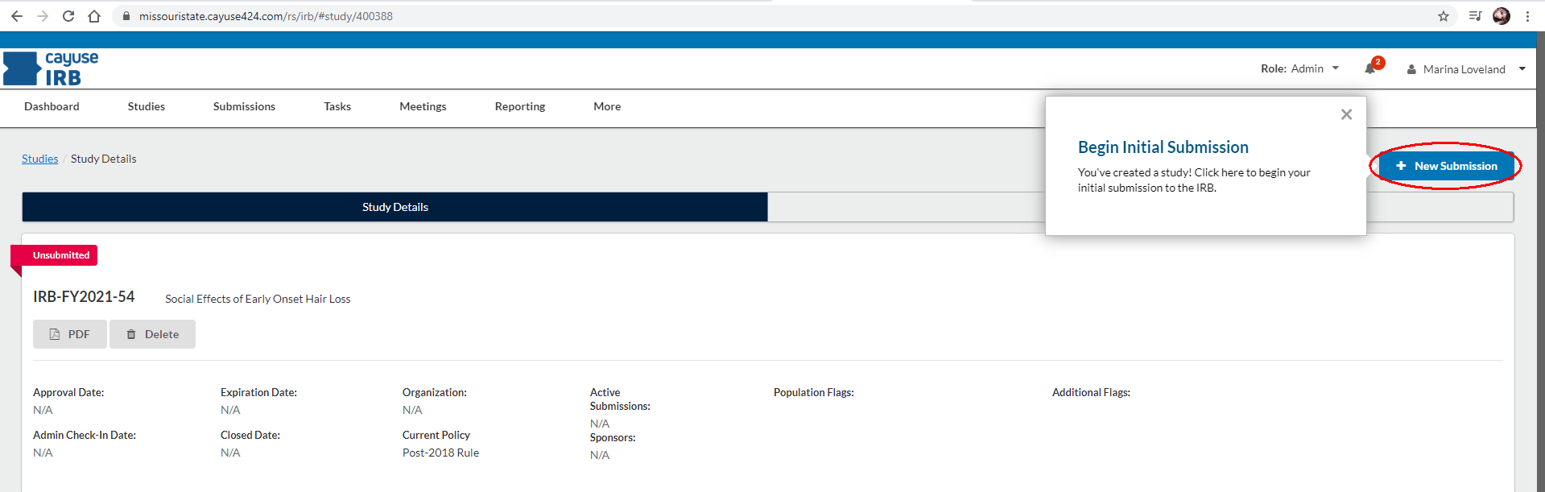
Submit Your Application
Creating an application
After creating the new study, you will be taken to the Study Details page. Click New Submission:

Slide 115
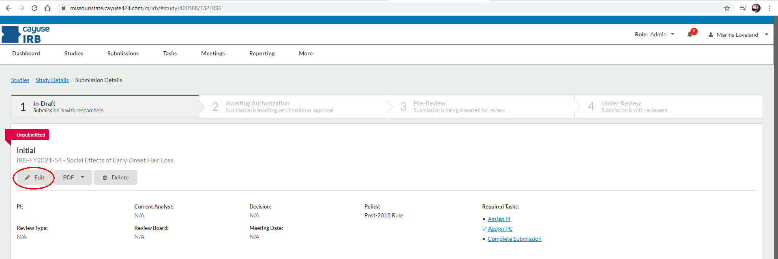
Submit Your Application
Creating An application
You can now edit the application, by clicking the edit button:

Slide 116
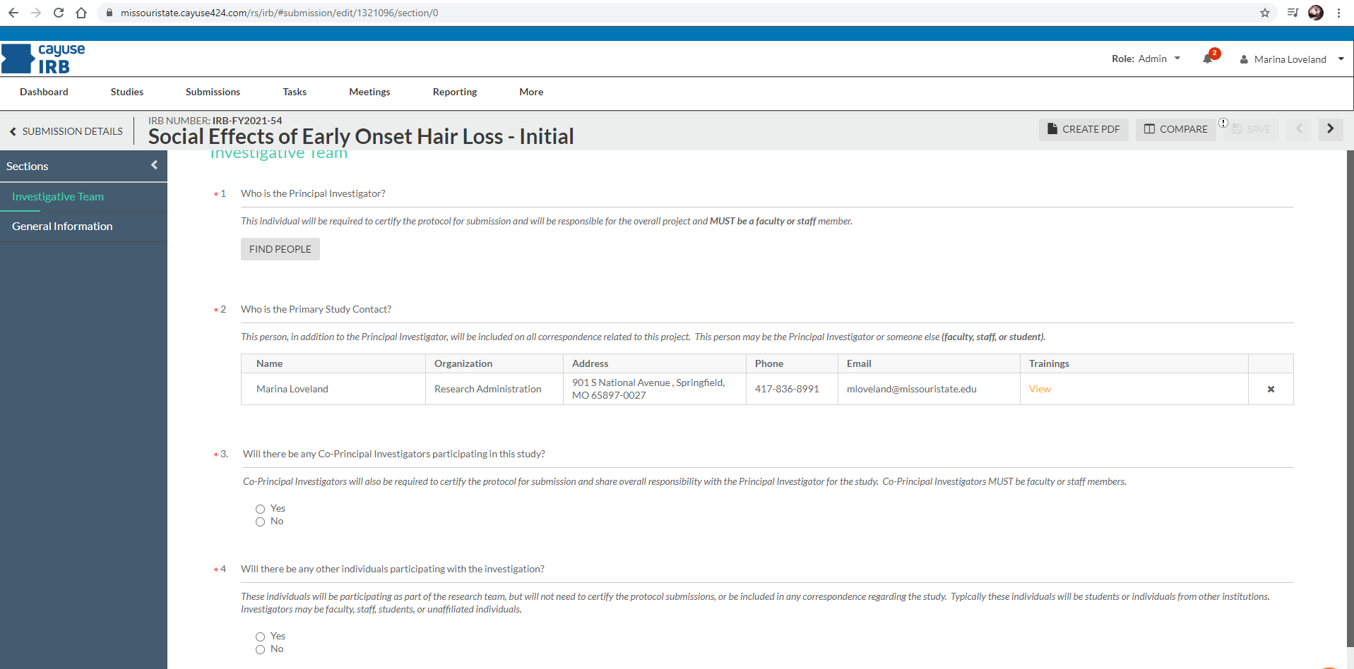
Submit Your Application
Investigative Team
Whomever creates the application will automatically be listed as the Primary Study Contact. This can be changed. But, please note, that if you want continued access to the application, you must be listed as the Primary Study Contact, or as an Investigator in question 4. Individuals listed in Question 1 and 3 must be MSU Faculty or Staff:

Slide 117
Submit Your Application
General Information – Dynamic Questions
The IRB Application itself is dynamic. You will see different sections of the application appear as you answer these dynamic questions within the General Information section of the application. This prevents you from having to give information that may not be necessary for review, as well as assists us in determining what type of review you will need for your study.

Slide 118
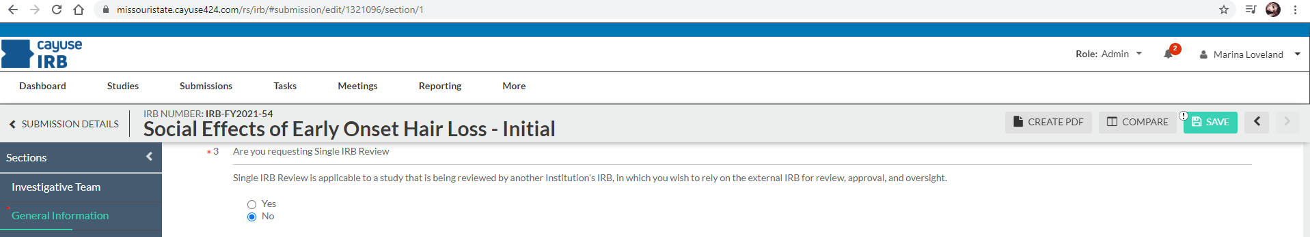
Submit Your Application
Dynamic Questions – Single IRB review
The first dynamic question is regarding the need for Single IRB Review:
Single IRB review is for studies that have already gone through an IRB review through a different institution, and you are requesting our IRB to rely on the other institutions IRB for review and approval.
For most of you, this will be answered as NO.

Slide 119
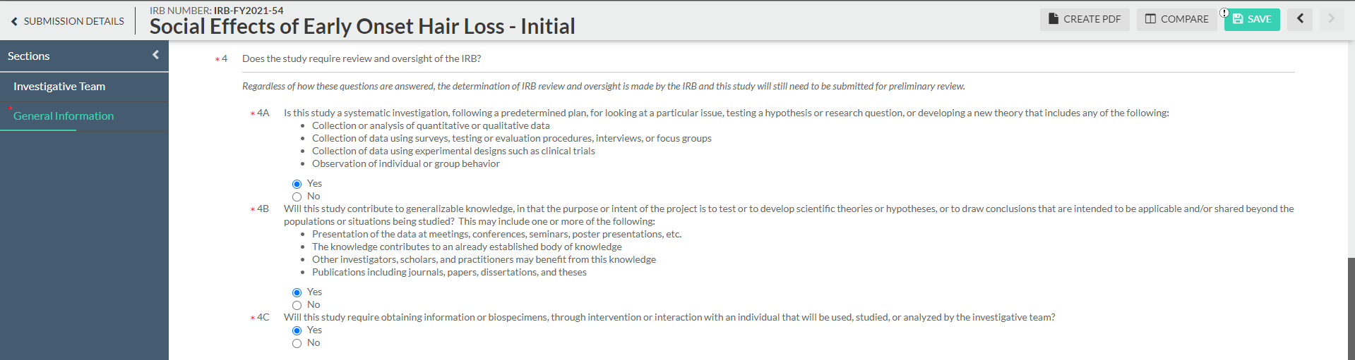
Submit Your Application
Dynamic Questions – Does the study require review
This question determines the need for IRB review:
For most of you, the above is how you will answer these questions. If you are unsure, you can contact our office for guidance. Or, answer to the best of your ability and submit the application, in which case we will follow-up with further questions if necessary.

Slide 120
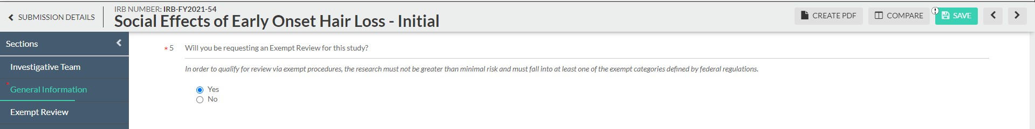
Submit Your Application
Dynamic Questions – Exempt Review
Certain project types can request an Exempt Review (see slides 27 - 31). In most cases this will decrease the amount of information you will need to provide for the review, and reduce the amount of time your review will take:
Many of your project designs will likely qualify for an exempt review.

Slide 121
Submit Your Application
What Attachments You will need for submission
You will need to include some attachments to your Application for review:
Any research instrument that will be used in the study (survey/interview questions, interventions, educational materials, etc.)
Site permission if applicable
Recruitment tools/flyers
Informed Consent and Assent documents to be used
Training Certificates if you have completed training through an institution other than Missouri State University

Slide 122
Submit Your Application
Informed Consent
Informed Consent is a very important part of the Application. You must be sure to include all of the federally required elements within your informed consent (written or oral).
You can find examples of informed consent here: https://ora.missouristate.edu/IRB_Informed_Consent.htm

Slide 123
Submit Your Application
Informed Consent Required Elements
A statement that the study involves research
An explanation of the purpose of the research
The expected duration of time of the participants involvement in the research
A description of the procedures to be followed
A description of any reasonably foreseeable risks or discomforts to the participant
A description of any benefits expected
A statement describing the extent to which confidentiality of records identifying the subject will be maintained
For research involving more than minimal risk, an explanation as to whether any compensation and an explanation as to whether any medical treatments are available if injury occurs and, if so, what they consist of, or where further information may be obtained;
An explanation of whom to contact for answers to pertinent questions about the research and research subjects' rights, and whom to contact (the Principal Investigator must be listed here) in the event of a research-related injury to the subject;
A statement that participation is voluntary, refusal to participate will involve no penalty or loss of benefits to which the subject is otherwise entitled, and the subject may discontinue participation at any time without penalty or loss of benefits to which the subject is otherwise entitled
One of the following statements about research that involves identifiable private information or biospecimens
  A statement that identifiers might be removed from the identifiable private information or identifiable biospecimens and that, after such removal, the information or biospecimens could be used for future research studies or distributed to another investigator for future research studies without additional informed consent from the subject or the legally authorized representative, if this might be a possibility; or
  A statement that the subject’s information or biospecimens collected as part of the research, even if identifiers are removed, will not be used or distributed for future research studies

Slide 124
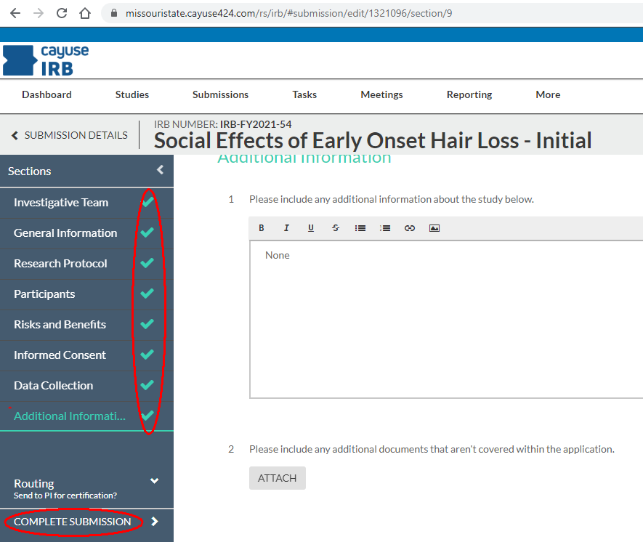
Submit Your Application
Finalizing and submitting your Application
Once you have finished all sections of your application you will see green check marks to the right of each section and the COMPLETE SUBMISSION link will appear:
Click COMPLETE SUBMISSION, and then confirm the submission.

Slide 125
Review Process

Slide 126
Review Process
Sumission Review Workflow
There are several stages of review for your Application once it has been submitted:
Your Principal Investigator and any listed Co-Principal Investigators will review and confirm the submission
The Department Heads of PI’s and Co-PI’s will review and approve the submission
An IRB analyst will give a pre-review to confirm training, that all necessary attachments are present, and determine what type of review it will require.
Review by either an IRB Analyst, if it is determined for exempt review, or an IRB Representative, if it is determined for expedited or full board review.
An IRB analyst will then finalize the review by either sending you your approval/denial or requesting changes to your submission
This process can take up to two weeks for completion, but can take longer dependent upon circumstances. If your project has to go to a Full Board Review, it could take longer.

Slide 127
Review Process
Review Types – Single IRB Review
Single IRB Review – You can request a Single IRB Review from the General Information Tab of the application. You would choose this option if the study you are involved in is required to be reviewed by another institution (Mercy, Cox, another University, etc.) and you wish to rely on their IRB for review, approval, and oversight. These reviews are conducted by the IRB Chair and can take up to 2 weeks for review.

Slide 128
Review Process
Review Types - Exempt
Exempt Review – Exempt does not mean that you do not have to submit to the IRB. This is a status that is given by the IRB, to a reviewed project, which exempts the project from continued review by the Board (unless changes are made to the protocol). If your project is deemed exempt, you would not have to renew it annually, as is required for some Expedited projects, and for all projects that require a Full Board Review. You can request an Exempt Review from the General Information Tab of the application. There are 6 categories of exemption that the IRB will accept for this type of review.

Slide 129
Review Process
Review Types – Exempt – Category 1
Exempt Category 1 – Research in established or commonly accepted educational settings, that specifically involves normal educational practices.
The research cannot adversely impact the students’ opportunity to learn.
The research cannot adversely impact assessment of educators providing instruction.
If you are including interventions that are not normally provided in normal curriculum, or surveys/interviews you cannot use Category 1 for an exemption.

Slide 130
Review Process
Review Types – Exempt – Category 2
Category 2 – Research that only includes interactions involving educational tests (cognitive, diagnostic, aptitude, achievement), survey procedures, interview procedures, or observation of public behavior.
The research cannot include any interventions.
The research cannot include prisoners or children as participants
The recorded information collected from the participant must be de-identified. (no personally identifying information can be collected)
The research cannot place the participant at risk (criminal, civil liability, financial, employability, educational advancement, or reputation) should the participants responses be disclosed outside of the research.

Slide 131
Review Process
Review Types – Exempt – Category 3
Category 3 – Research involving benign behavioral interventions in conjunction with the collection of information from adult participants through verbal or written responses (including data entry) or audiovisual recording if the participant prospectively agrees to the intervention and information collection.
The research cannot include children or prisoners as participants
The research cannot include any medical interventions.
The research cannot include any deception methods
The benign behavioral intervention must be:
  Brief in duration
  Painless/Harmless
  Not physically invasive
  Not likely to have significant adverse lasting impact on the participants
  Unlikely to be found offensive or embarrassing to the participants
The information collected cannot readily identify the participant, directly or indirectly. Meaning no identifying information can be collected. If you are using a key containing the participants names with their corresponding pseudonyms or assigned participant numbers, it will not qualify as an exempt study.

Slide 132
Review Process
Review Types – Exempt – Category 4
Category 4 – Secondary research for which consent is not required (data or biospecimen).
The data must already be available to the public, OR
The data is de-identified. Meaning there are no identifiers included in the data (directly, or indirectly). The investigator cannot contact, nor re-identify, the participants.

Slide 133
Review Process
Review Types – Expedited Review
Expedited Review - The Expedited Review process is used for research project that do not qualify for an exemption, but still pose no more than minimal risk to the research participants. Those studies that are reviewed under this process may be required to be reviewed annually and are subject to Federal Regulation (CFR 45 Part 46). These reviews are conducted by a Member of the IRB and can take up to two weeks for initial review.

Slide 134
Review Process
Review Types – Full Board Review
Full Board Review – These reviews are reserved for research projects that pose more than minimal risk to participants. Projects that have been approved under a Full Board Review will require continuing review of the research at intervals appropriate to the degree of risk, but not less than once per year. Because this review process requires that the Institutional Review Board convene to review the research, it can take longer for the IRB to forward decisions to Investigators. Board meetings are only held once per month, if necessary.

Slide 135
Assistance

Slide 136
Assistance
Where to seek guidance
Assistance can be found in several places:
Contact the Principal Investigator that has been assigned to you study.
Contact the IRB Member that oversees your Department: https://ora.missouristate.edu/IRB_Members_Meetings.htm
Contact the Office of Research Administration:
  Marina Loveland – IRB Administrator at mloveland@missouristate.edu or 417-836-8991
  The Office of Research Administration at irb@missouristate.edu or 417-836-5972

